Slide 1









SPECIAL
PIZZA
SALE
UP TO
50%
OFF
Contact Us:
+123-456-7890
ORDER NOW
www.reallygreatsite.com

Slide 2
Introduction
Hello everyone!
I am Ritika prajapati
In this presentation, I’ll share key insights from a Pizza Sales Analysis project done using SQL. The goal was to analyze sales data to identify top-selling pizzas, peak hours, and revenue trends.
Using SQL, I queried the database to extract useful metrics and patterns that can support better business decisions.
Let’s explore the findings!

Slide 3
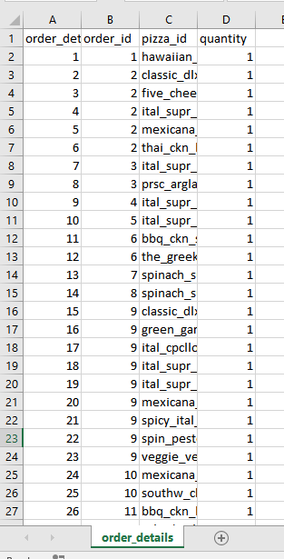
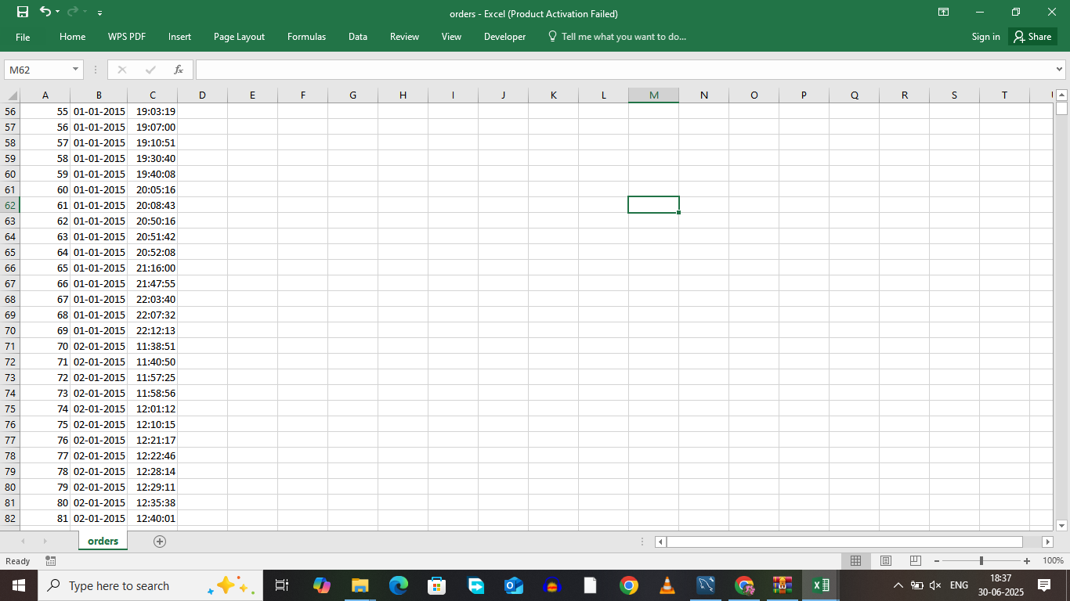
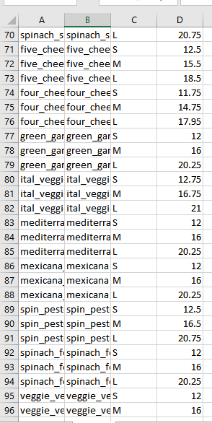
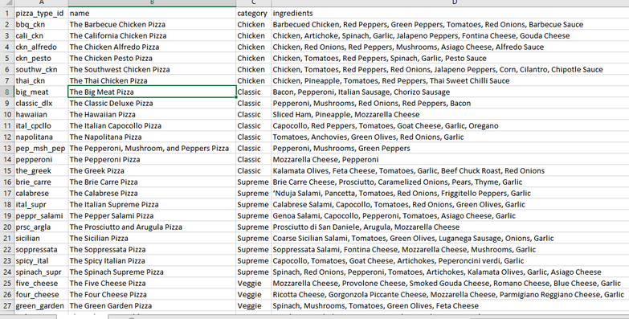
This is the “Dataset” i have used

Slide 4
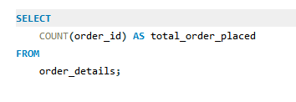
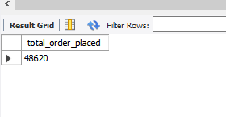
Q1 Retrieve the total number of orders placed.

Slide 5
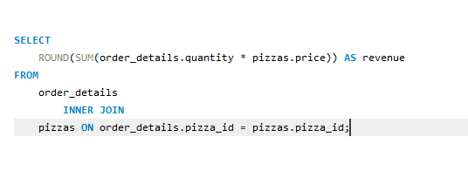
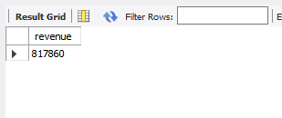
Q2 Calculate the total revenue generated from pizza sales.

Slide 6
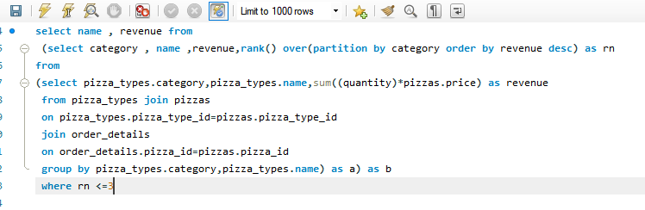
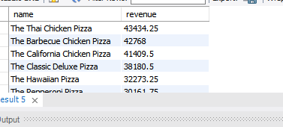
Q3 Determine the top 3 most ordered pizza types based on revenue for each pizza category.

Slide 7
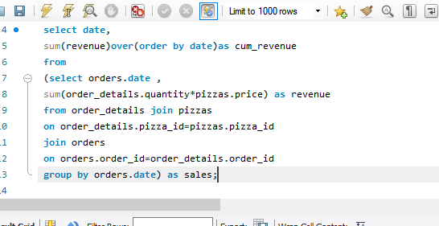
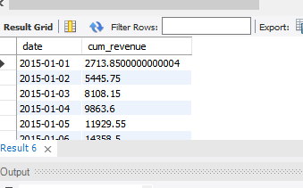
Q4 Analyze the cumulative revenue generated over time.

Slide 8
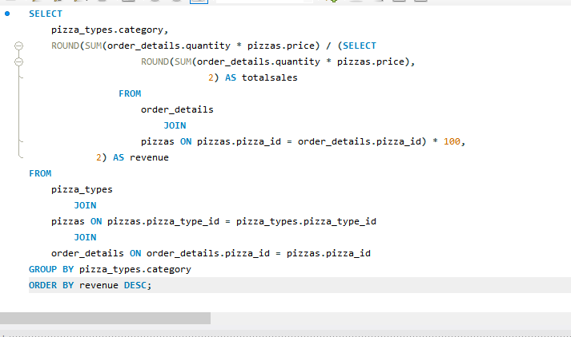
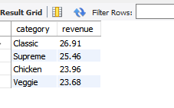
Q5 Calculate the percentage contribution of each pizza type to total revenue.

Slide 9
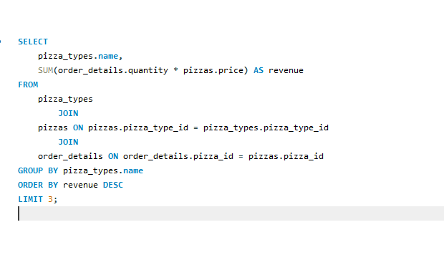
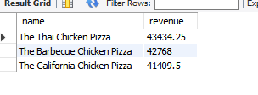
Q6 Determine the top 3 most ordered pizza types based on revenue

Slide 10
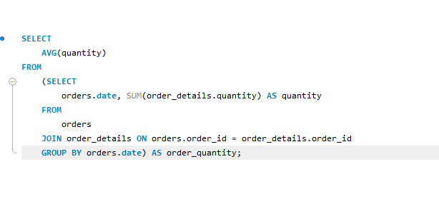

Q7 Group the orders by date and calculate the average number of pizzas ordered per day

Slide 11
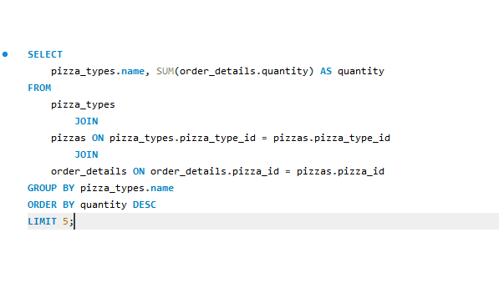
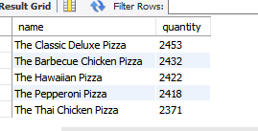
Q8 List the top 5 most ordered pizza types along with their quantities

Slide 12
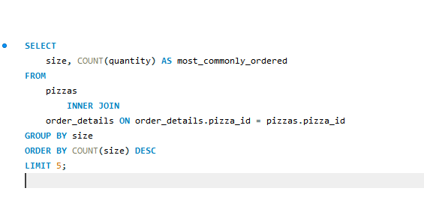
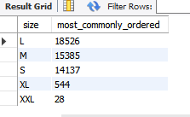
Q9 Identify the most common pizza size ordered

Slide 13
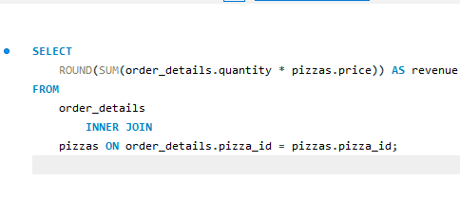
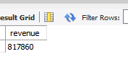
Q10 Calculate the total revenue generated from pizza sales

Slide 14
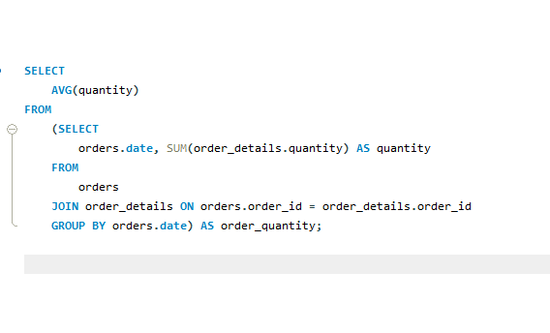
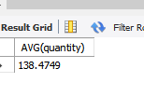
Q11 Calculate the average number of pizzas ordered per da

